Slide 1

LCD Splicing Screens Wall-mounted Guide

Slide 2
Take 2×2 splicing screens as example
We can support wall-mounted for 46” and 55”
Standard: 1×1, 1×2, 1×3, 2×2, 2×3.

Slide 3

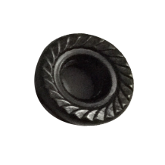




Material
Bolt
×24
×32
×24
×16
×72
×6
A
B
C
D
E
F

Slide 4
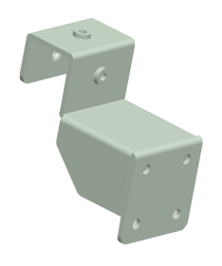

Material
Hook Rack
Member
×16
G
×3
×4
H
I

Slide 5
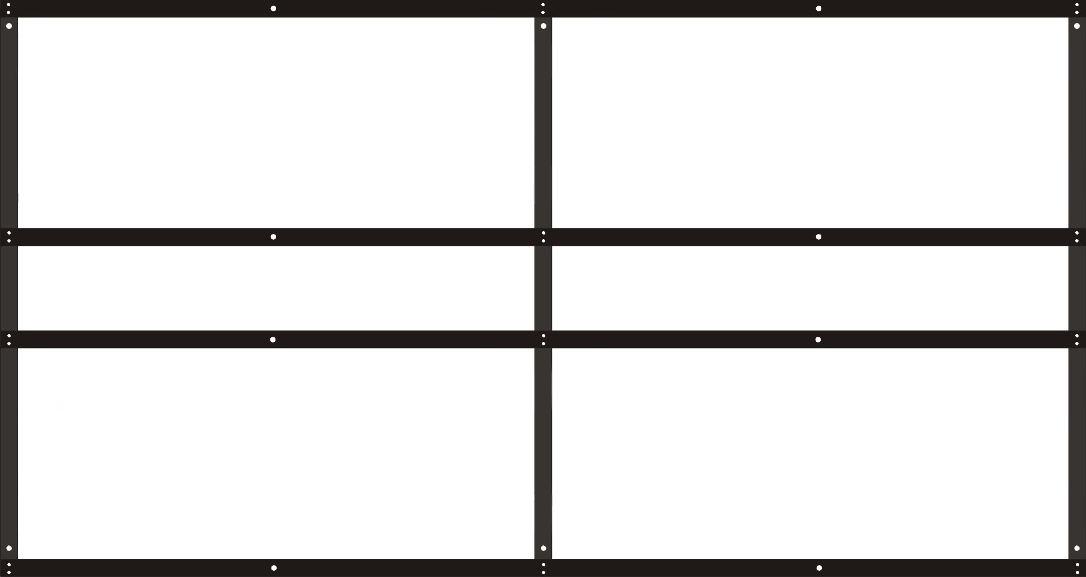
Installing Step 1:
A B
Assemble bracket

Slide 6

Installing Step 2:
F
Install the anchoring:

Slide 7
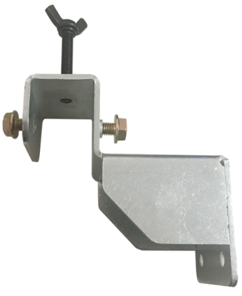
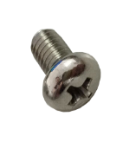
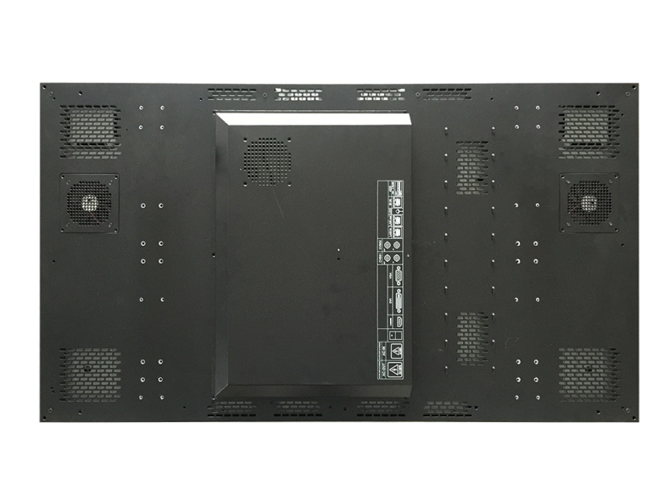
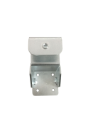
Installing Step 3:
Replace the origin pothook

Slide 8
Installing Step 4:
Install screens

Slide 9

Installing Step 5:
Adjust the location of screens and fix the screws.
Up & Down
Front & Back
Front & Back

Slide 10

Make your life safe.

